Slide 1
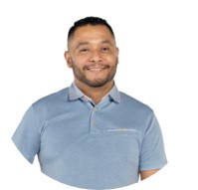
EL BANDIDO
Jorge, also known as "Bandido," is a distinguished radio professional with 27 years of experience. Originally from Monterrey and raised in Phoenix, he started his career at 17, quickly making a name for himself in the industry. His talents extend beyond radio into TV commercials and audio/video production, showcasing his versatile skills.
Jorge is a proud family man, happily married with three daughters. He’s passionate about photography, especially capturing landscapes and wildlife. His diverse endorsement portfolio includes restaurants, legal services, and car dealerships, and he remains open to exploring new opportunities.
Known for his cheerful and respectful nature, Jorge’s cooking skills also stand out—his culinary creations have earned him rave reviews. With his extensive experience and engaging personality, Jorge "Bandido" is an exceptional choice for any project or endorsement.

