Slide 1
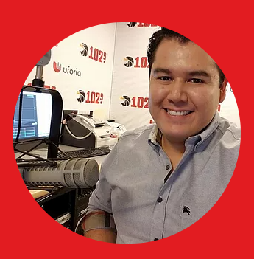





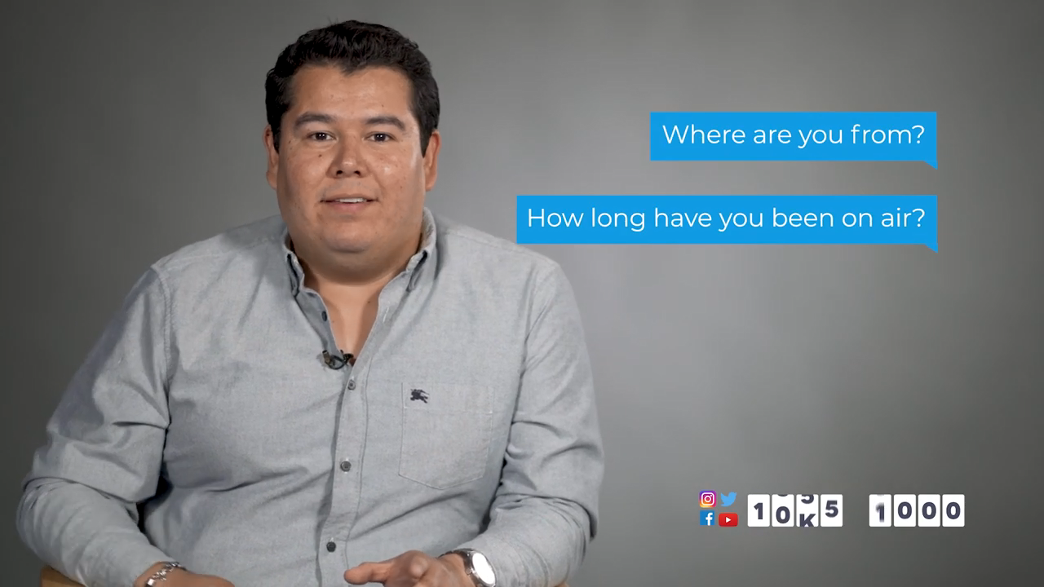
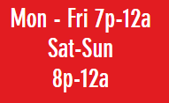


Roberto Morales, a.k.a. “Beto,” was born in Nuevo Laredo, Tamaulipas, and lived in Laredo, TX, for six years. He recently moved to Houston to pursue his career in radio.
As a small child, he had a fascination for voice acting and love for music. Beto is known for his unique voice- over talent, and engagement with all his fans and friends on Facebook & Twitter. He is deeply involved with non-profit organizations like St. Jude, and has endorsed clients like O’Reilly, Telcel & Metro PCS to mention a few.
​
When Beto’s not on the radio, he loves to spend time with his family, watch movies, and go out to eat with friends. He also enjoys learning new languages, martial arts, and reading about psychology.

